Slide 1
On Grasp Choice, Grasp Models, and the Design of Hands for Manufacturing Tasks
Mark R. Cutkosky
Presented by Edward Venator

Slide 2
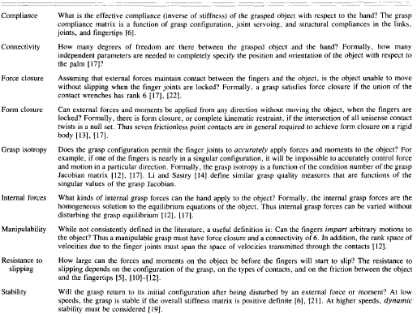
Definitions of Analytical Measures Used to Describe a Grasp

Slide 3
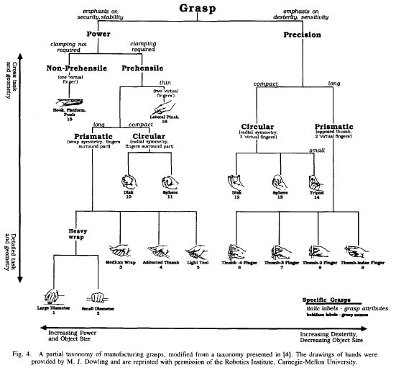
Grasp Taxonomy

Slide 4
Trends in Grasp Taxonomy
Grasps can be represented as a continuum, rather than discrete grasps.
Grasp 13 becomes grasp 14 as the object manipulated gets smaller. Finally, for the smallest objects, they approach grasp 9.

Slide 5
Grasp Expert System

Slide 6
Human Grasp Attributes
Grasp Expert Attributes Correlate with Analytic Grasp Measures
Dexterity correlates with manipulativity and isotropy
Precision correlates with isotropy
Sensitivity correlates with isotropy and stiffness
Stability correlates with stiffness, force/form closure, and friction constraints
Security correlates with friction constraints

